Slide 1
Presentation of the Investment Project:
- Production of block-modular gas-fired boiler houses

Slide 2
Municipal contract No. 146 of 16.11.2020 for the provision of services for municipal needs
Subject:
Provision of services for the creating (updating) of business plans, technical and economic feasibility studies for inclusion in the Unified Information System (the Single Database on Investment-attractive Land Plots in the Krasnodar Territory, the Unified Register of Investment Projects of the Krasnodar Territory) for municipal needs (hereinafter - Services).
Customer: Municipal Administration of Apsheronsky District of the Krasnodar Territory
2

Slide 3
Land plot information::
Address:
Cadastral number:
Area:
Krasnodar Territory, Apsheronsky District, Kalinin Farm Area, Plot 1, Section 35, Contour 45
23:02:0209000:730
9,2 Ha
Land use category:
Permitted use:
Owner:
Lands for industry, energy, transport, communications, radio broadcasting, television broadcasting, informatics, lands for outer space activities, lands for defense, security and other special purposes
For the placement of other industry facilities, production activities (production facilities and sites of hazard class IV)
State property
3

Slide 4
Name of types of products, works and services (planned for implementation): - 1.5 MW Block-Modular Gas-fired Boiler House - 2.0 MW Block-Modular Gas-fired Boiler House - 3.5 MW Block-Modular Gas-fired Boiler House - 4.0 MW Block-Modular Gas-fired Boiler House - 4.5 MW Block-Modular Gas-fired Boiler House Core market: housing and utilities management companies, developers of commercial and residential real estate, industrial enterprises, objects of state significance Project capacity in kind and in value terms (mln. RUB.): Total project cost: 402 mln. RUB. Investment requirement: 402 mln. RUB. Key indicators of economic efficiency: simple pay-back period – 4.12 years net present value (mln. RUB.) – 80.6
Project information:
Name of the investment project: Production of gas-fired boiler houses
4

Slide 5
Information on the infrastructure support of the investment site:
Power supply: 240 m from the plot
Gas supply: 1400 m from the plot
Water supply: 1100 m from the plot
Distance from the nearest paved road: 680 m from the plot
Distance from the nearest railway station: 21,000 m from the plot
5

Slide 6
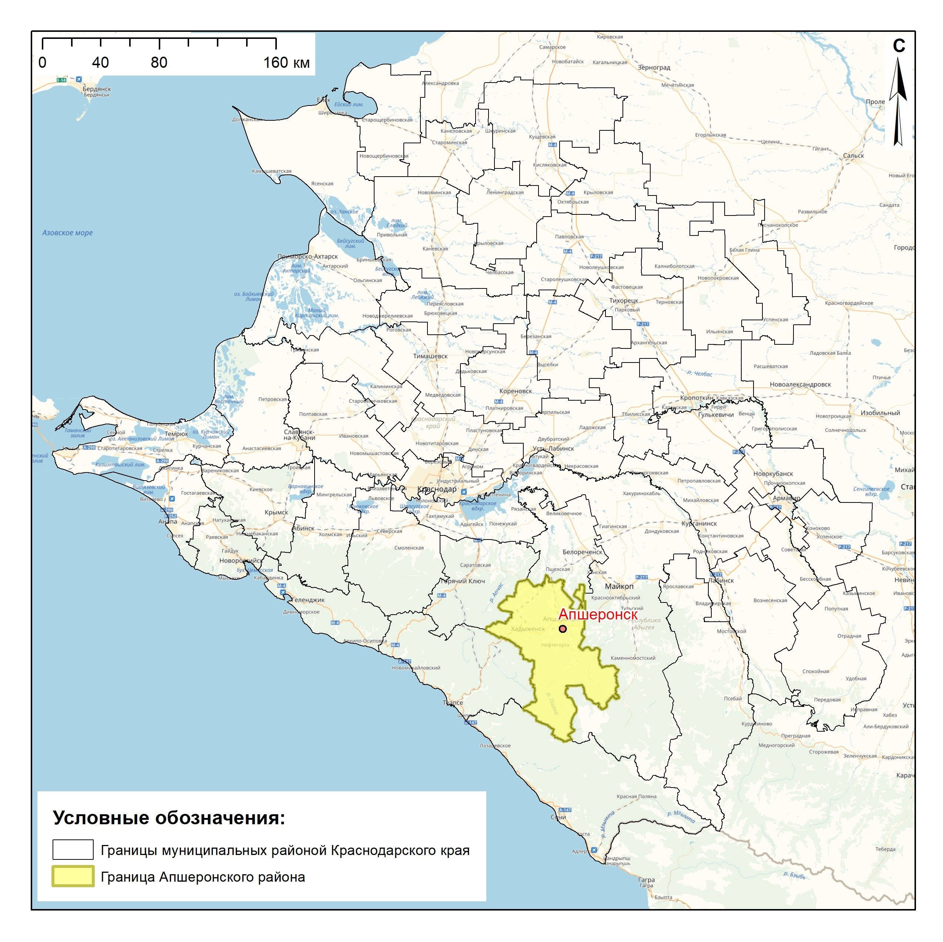
Drawing with the highlighted boundaries of the municipal district:
6

Slide 7
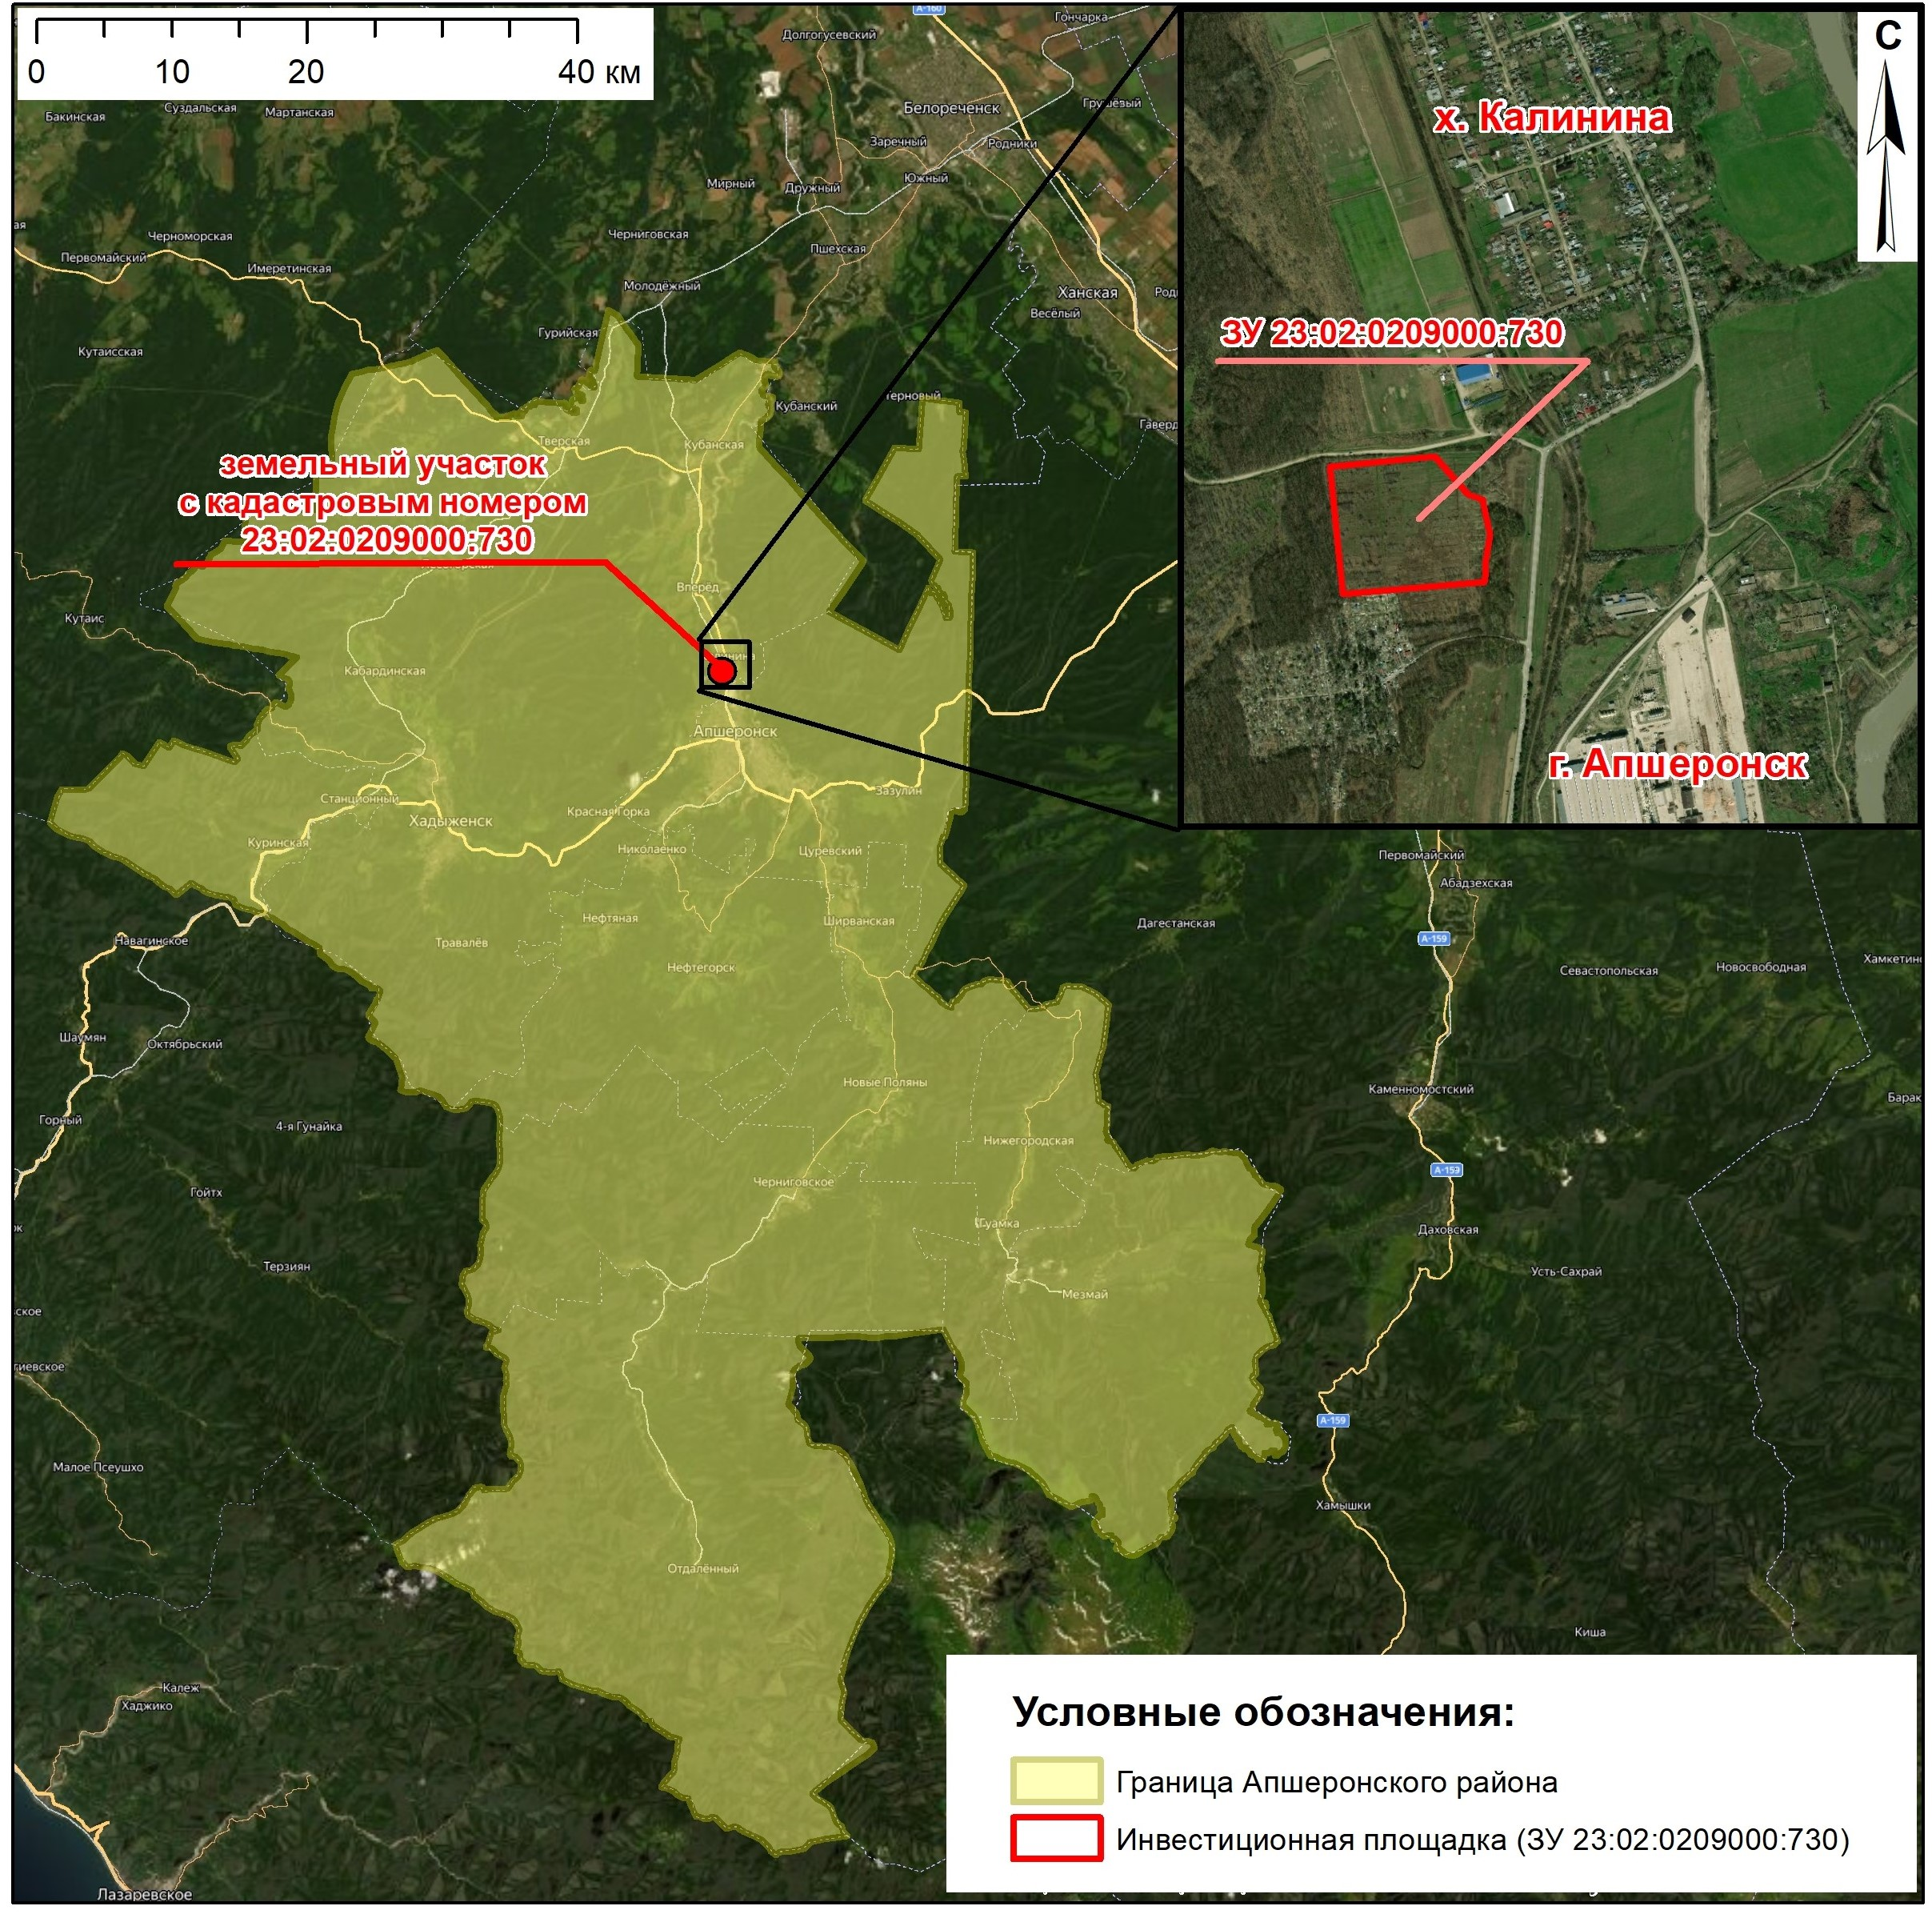
Satellite image of the municipality and the allocated plot of land planned for the implementation of the Projects:
7

Slide 8
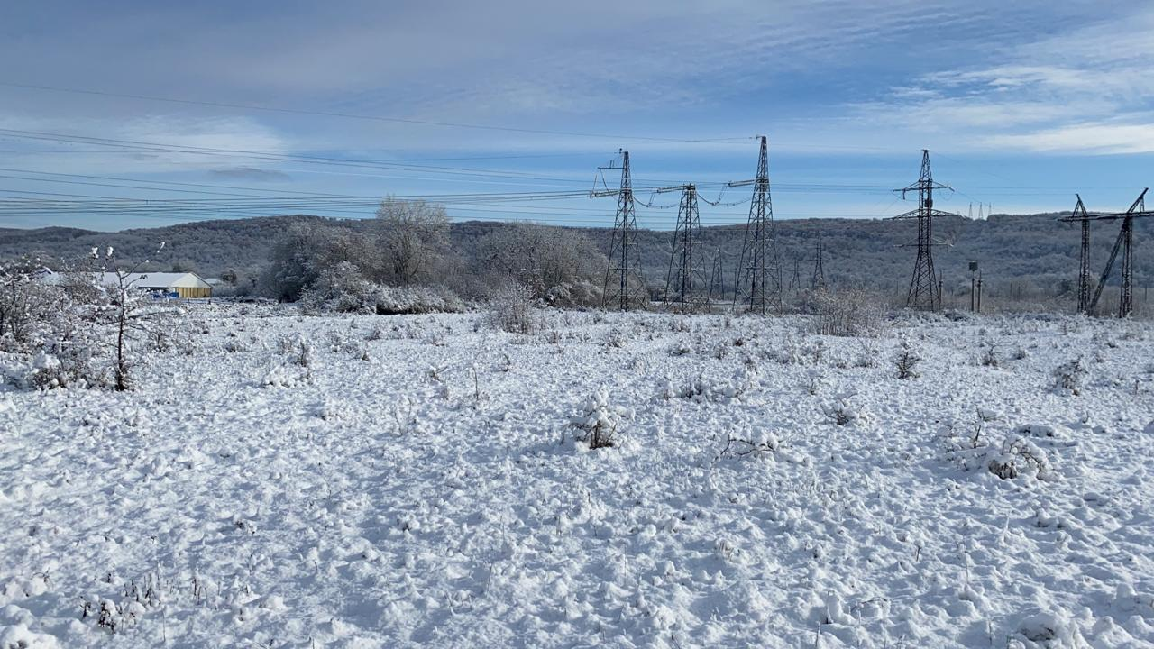
Photos of the plot of land on the earth:
8

Slide 9
The applicant's contact details:
Name: Municipal Administration of Apsheronsky District
Mailing address: 17 Kommunisticheskaya Street, the town of
Apsheronsk, 352690 Krasnodar Territory
Web-site: http://www.apsheronsk-oms.ru/
Telephone/fax: 8(86152)2-57-73
E-mail: apsheronsk@mo.krasnodar.ru
9

Slide 10
THANKS FOR YOUR TIME!
10
2020

